Slide 1


What is Exponential Smoothing?

Slide 2
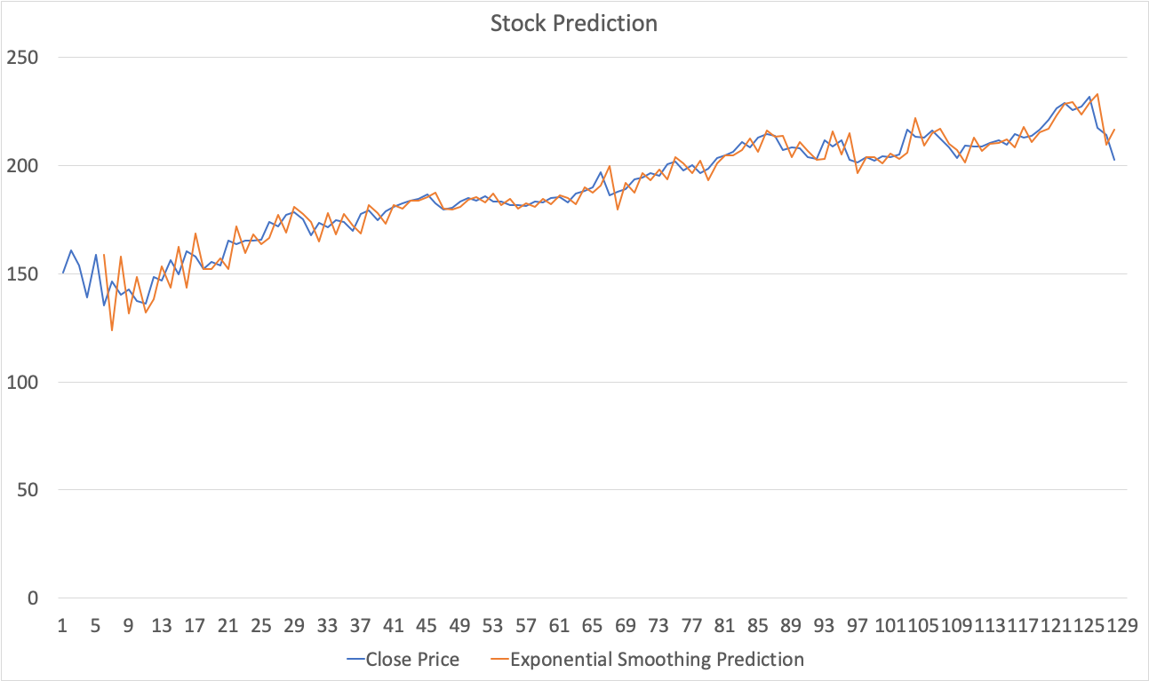

Slide 3
A time series forecasting method where prediction is a weighted sum of past observations

Slide 4
Exponential smoothing uses an exponentially decreasing weight
The more recent the observation, the higher the associated weight

Slide 5
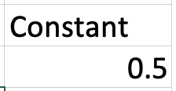
Single Exponential Smoothing requires one constant, a smoothing factor

Slide 6
Factor controls the rate at which influence of prior observations decay exponentially

Slide 7
Factor is usually between 0 and 1
0
1

Slide 8
Larger factor means model gives more weight to most recent past observations

Slide 9
Formula
error = (previous actual value - previous predicted value)
Predicted value = previous predicted value + constant * error

Slide 10
What is Exponential Smoothing? ✓
Let’s begin...

